Slide 1
Smart Bridge Externship

Slide 2
Team-Matrix
Prediction of crude oil prices
-Vinay(18BEC0636)
-Harpreet(19BME0781)
-Vaishnavi(18BCE7056)
-Shriya(19BCE10081)

Slide 3
Introduction
The accuracy of forecasting and prediction is more important and can assist organizations to take up-to-date decisions for better planning and management. So, we proposed the crude oil prediction model performance, different evaluation measures are used including Root Mean Square Error (RMSE) test. All the forecasting accuracy measures confirmed that our proposed model performs well in crude oil prices forecasting as compared to other hybrid models.

Slide 4
Problem Statement
Crude oil is the largest source of energy for the world. The prices of fuel price are in continuous fluctuation which makes it difficult to predict the price of fuel. Being such an important commodity it is important to know the price of the fuel. Hence our project aimed to make a model which can predict the fuel price for the next day based on previous data

Slide 5
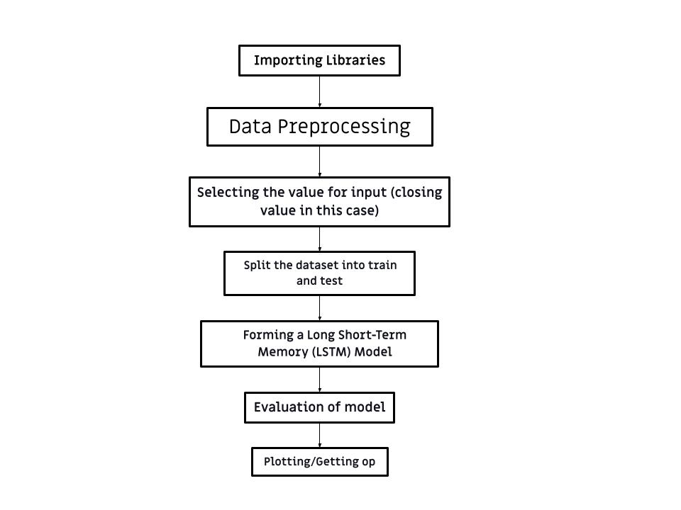
Flow Chart

Slide 6
Proposed Solution
We will use LSTM (Long Short Term Memory). and mean square error to estimate the crude oil prices for the given data set.We will predict the test and train data and will plot the graph accordingly. Predicting the price of crude oil for future 10 days. Plotting the graph for the prediction.

Slide 7
Methodology
First of all, we will import the libraries namely pandas, NumPy, and matplot.lib.pyplot. Then we will import the dataset. Then we will run the dataset command to view our dataset. On running dataset.info we will get information about data in our dataset then we will check if there are any null values in the dataset if null values are present we will fill the null values. We will take the closing value as our input. Plotting the graph for the input values. We will apply MinMax scaler in feature scaling. Then we will split the dataset into train and test we will convert values from array to dataset matrix. Using X_train and Y_train to to view the values in them, then we will prepare the input to be entered into LSTM (Long Short Term Memory). Importing Sequential, Dense, and LSTM. Using model.summary we can get detail about our model. Model evaluation using RMSE(Root Mean Square Error) performance metrics. We will predict the test and train data and will plot the graph accordingly. Saving as .h5 file . Predicting the price of crude oil for future 10 days. Plotting the graph for the prediction

Slide 8
Results

Slide 9
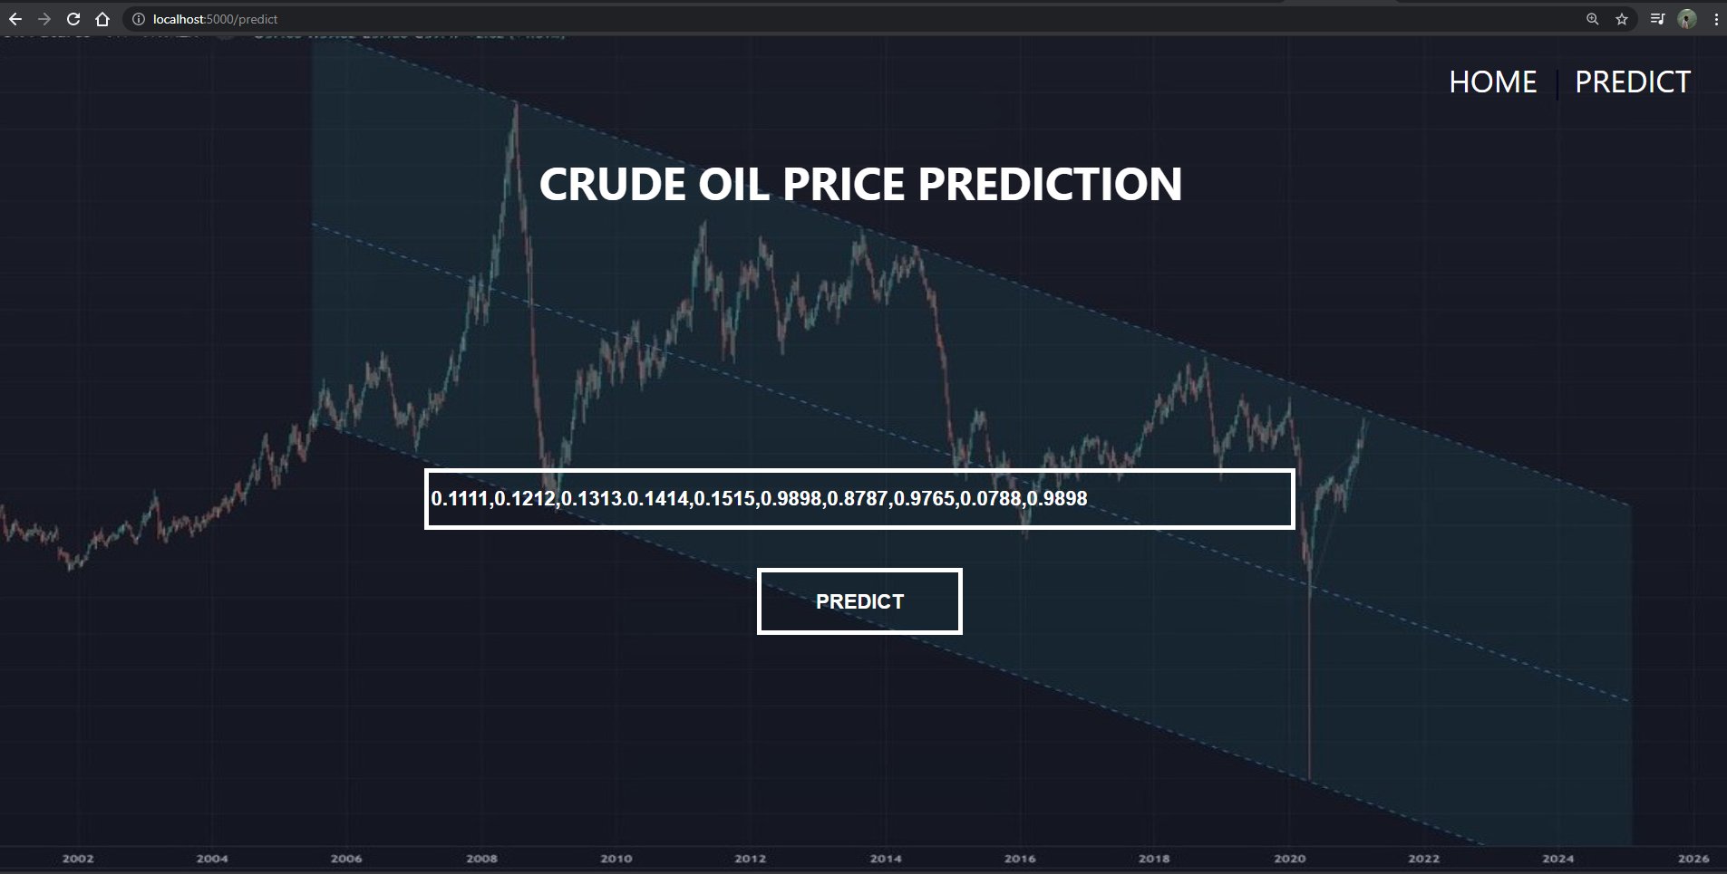

Slide 10
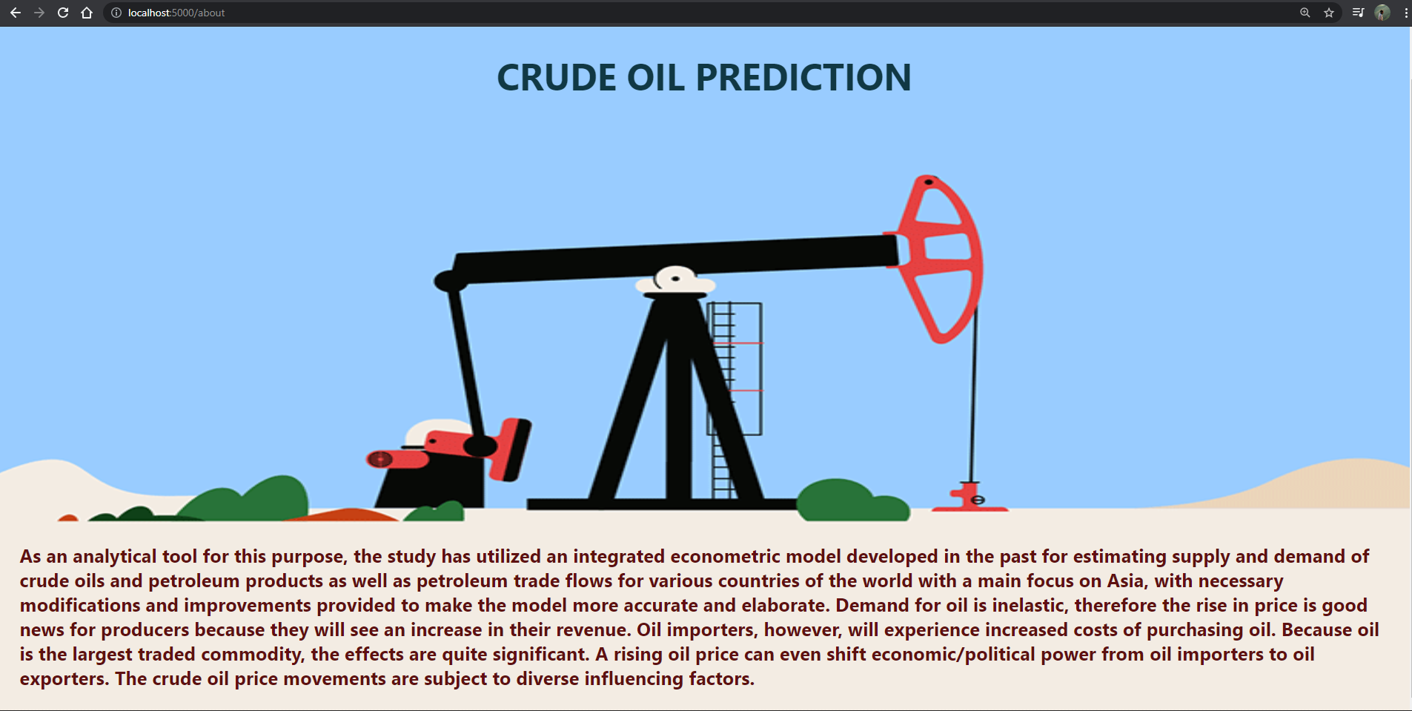

Slide 11
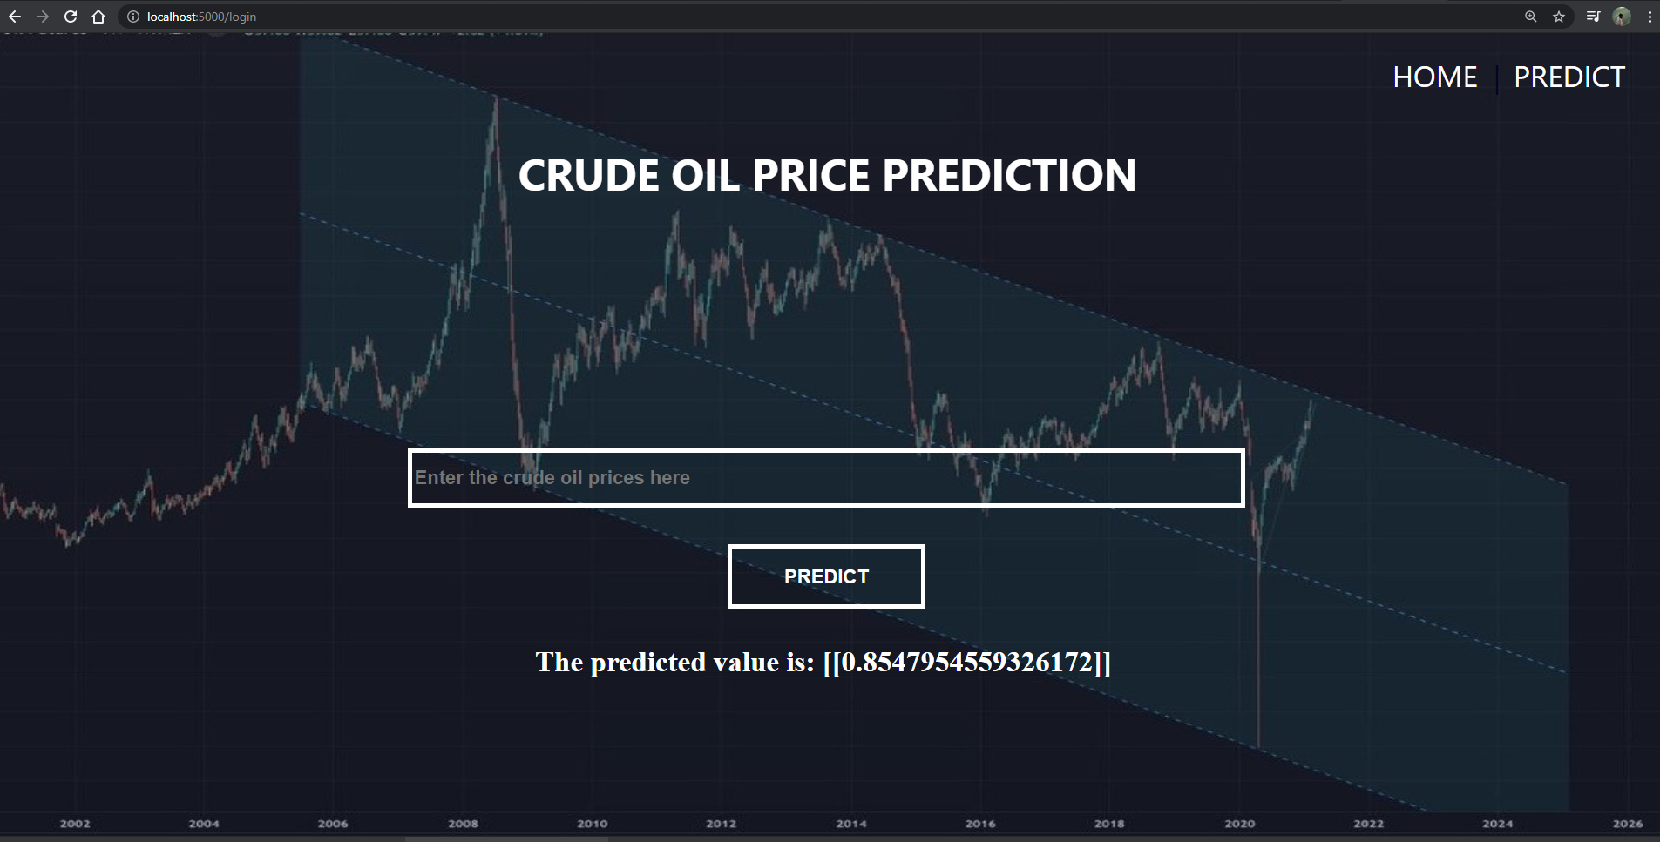

Slide 12
References
http://citeseerx.ist.psu.edu/viewdoc/download?doi=10.1.1.206.4394&rep=rep1&type=pdf
http://researcharchive.lincoln.ac.nz/handle/10182/5198
http://citeseerx.ist.psu.edu/viewdoc/download?doi=10.1.1.1066.9415&rep=rep1&type=pdf
http://eprints.lmu.edu.ng/3224/
https://www.sciencedirect.com/science/article/abs/pii/S0306261914013026

